Slide 1

14. Optimal Estimation: Designing Constraints
Dr. David R. Thompson
Jet Propulsion Laboratory, Imaging Spectroscopy Group
July 20, 2019

Slide 2
Goals for this module
Construct surface models for different retrieval objectives
Diagnose and exploit the information balance between prior and measurement data

Slide 3
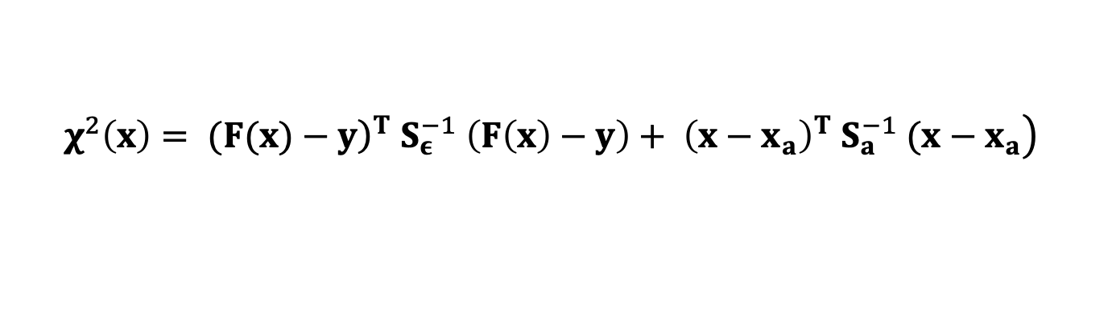
The prior distribution is tool to direct measurement information to specific goals
Introduces “soft” domain knowledge and background information
Can constrain certain parts of the state vector to provide maximum measurement leverage, or achieve specific inversion objectives
Can apply to any state vector element
Recall the cost function:
Prior mean Prior covariance
$$\left.χ^{2}\left(x\right)= ({\left.F(x)−y\right)}^{T} S_{ε}^{−1} \left(F\left(x\right)−y\right)+ {\left(x−x_{a}\right)}^{T} S_{a}^{−1} (x−x_{a}\right)$$
Bayesian prior

Slide 4
Example: surface priors
It is common to parameterize surfaces by specifying the reflectance independently in each channel.
In this case one reasonable prior would be a collection of Gaussians, formed by clustering “universal” libraries of diverse spectra
At retrieval time, we pick the ”nearest” (via Mahalanobis or Euclidean distance) to serve as the prior mean and covariance for that inversion
Some useful tricks:
Heavy regularization, i.e. diagonal loading, can broaden the distributions to ensure that they can retrieve arbitrary shapes
Since magnitudes vary, we represent covariances and means in normalized form (L2- or L1-normalized) and scale them to the magnitude of each new spectrum. This constrains shapes only
It is useful to limit distance calculations to reference wavelength intervals selected for resilience to atmospheric distortions.

Slide 5
Example of multi-component surface models
[Thompson et al., Remote Sensing of Environment 216, 2018]

Slide 6
Interpreting covariance matrix structure
Imagine a state vector partitioned into three groups (A,B,C)…. Leading to the following block decomposition of the covariance matrix.
The Red area is the marginal covariance of A. It is our best estimate of p(A) if no other variables are observed.
A | 0 | A,C
0 | B | 0
C,A | 0 | C
A
The Green area is the marginal covariance of B. Zeros outside of the diagonal blocks mean that it is independent of all other state vector elements.
B
The Striped area is the marginal covariance of the state vector combining A and C. It is independent of B,
C

Slide 7
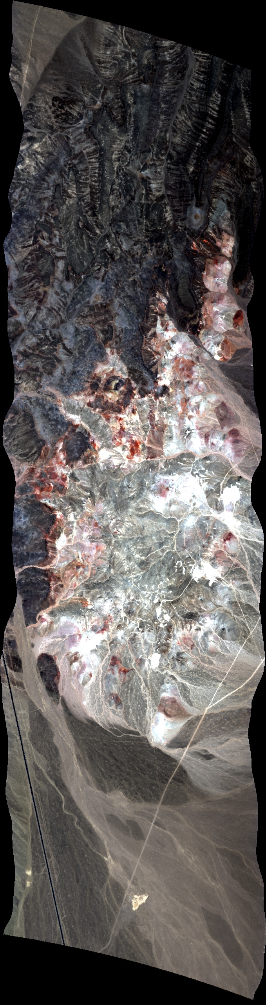
Overconstrained prior distributions can induce bias
Example: Cuprite, Nevada,
AVIRIS-NG instrument

Slide 8
Overconstrained prior distributions can induce bias
Example: Cuprite, Nevada,
AVIRIS-NG instrument

Slide 9
Overconstrained prior distributions can induce bias
Example: Cuprite, Nevada,
AVIRIS-NG instrument

Slide 10
But underconstrained priors can leave residual artifacts and noise
H₂O vapor artifacts
Good mineral features

Slide 11
Solution: Design priors carefully
Squeeze, expand, fit, and diagonalize to move shape and magnitude information around the spectrum, according to your needs and the strength of background knowledge.
Here, a “block + diagonal” structure preserves sharp mineral features that do not appear explicitly in our prior.
At the same time, it reduces the 940 nm water vapor artifact
Solved!

Slide 13
Exercise: Cuprite, NV - ang20140625t192252
Buddingtonite Bump
Notes:
We measured 6 sites at Ivanpah, JPL, and Caltech.

